Slide 1
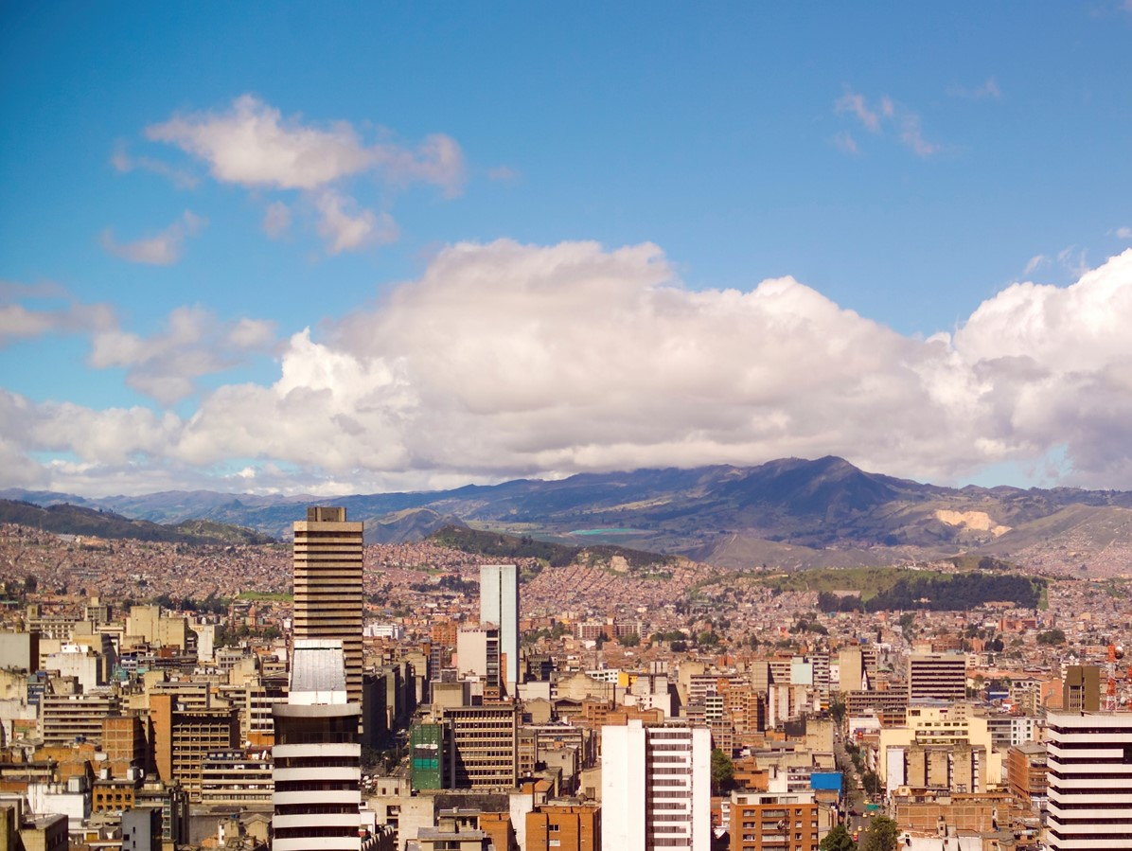

Mapathon Introduction

Slide 2
Welcome
Thanks for attending the <insert details> mapathon
While you are waiting for others to arrive, complete the below steps:
Sign up for an account at www.openstreetmap.org
Check your email and confirm your account by clicking the link provided!
Read through the steps on the guide on your table, to get familiar with how to map
Insert your logo and hashtag if relevant

Slide 3

What is mapping, and why do it?
Aim: Creating digital maps of the world’s ‘forgotten’ places by crowdsourcing. Described as ‘the human genome project for international development’.
Why: Many parts of the world most vulnerable to humanitarian crises such as natural disasters, disease outbreaks, epidemics or conflict are not mapped. People have limited/ no visibility to the situation on the ground.
Process:
Remote volunteers trace maps over satellite pictures, using a tool called OpenStreetMap
The maps are validated by remote experienced mappers
The maps are validated locally by volunteers, and details e.g. place names, identifying hospitals are added (project dependent)
Humanitarian organisations can then use mapped
information to plan risk reduction and disaster response
activities that save lives

Slide 4












When you map, you’re solving real world data challenges for NGOs, helping with:
Medical supplies
+ logistics
Infectious diseases e.g. Ebola
Vaccination campaigns
Waterborne diseases e.g. cholera
Malnutrition
Earthquakes
Hurricanes
Flooding
Missing Maps founders:

Slide 5
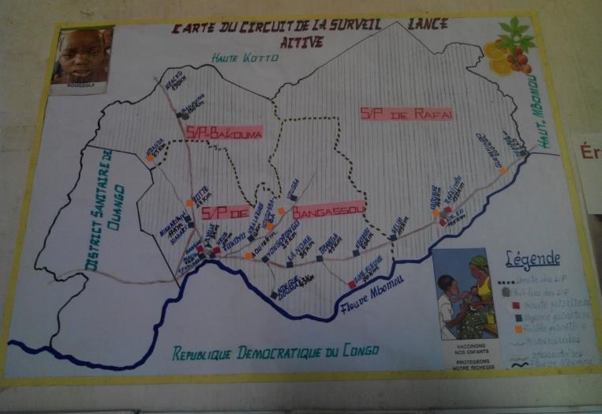
Current Maps
This is the highest quality map an NGO working in a location like the ones we map could expect to have. About 80,000 people live in the area shown below. From this map it’s hard to understand connectivity, population size, and how to pinpoint issues in the event of health crises or outbreaks

Slide 6
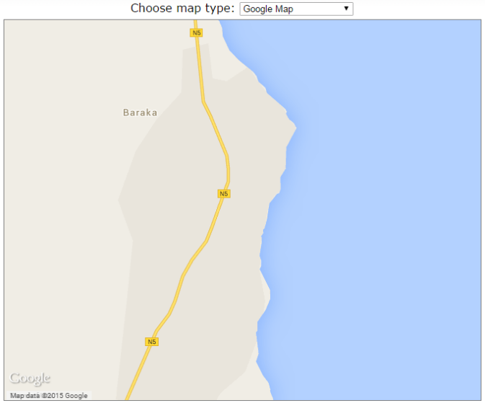
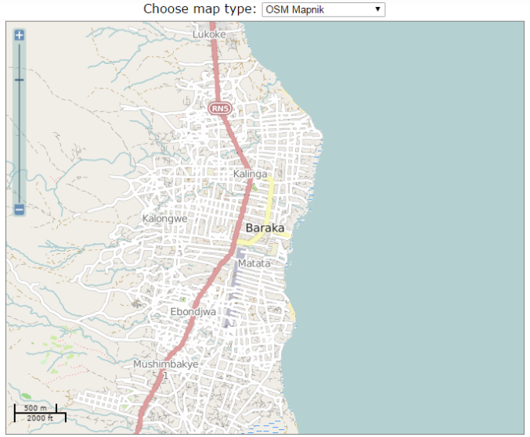
The impact of mapathons
This is a thriving trading city of 120,000 people – mapped in just one evening by 70 people!
Google maps still (to this date) shows no buildings in the area, whereas Open Street Map has thousands of buildings on an open source platform for all NGOs to use.
To see the below for yourself and zoom in to see the individual buildings mapped, click here
Open Street Map
Now
Google Maps Now

Slide 7
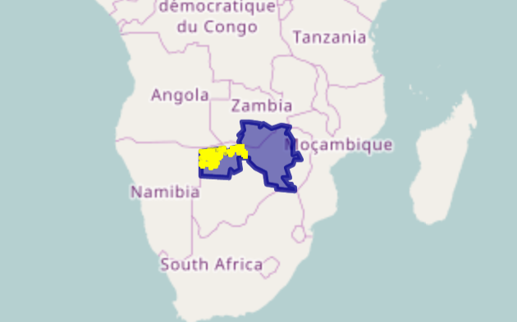
Example slide – it is great to share about the project and location with attendees. You can find project info on the description of the task in the tasking manager. You can find info about the place for mapping through Google.
Malaria Mapping
Background:
Malaria remains a leading killer of children under 5 years old in many countries around the world. HOT have teamed up with Clinton Health Access Initiative (CHAI), and Digital Globe, to create the data that’s needed to treat malaria more effectively, so children no longer die from this preventable and treatable disease.
This is HOT’s biggest ever project, mapping over 500,000 square kilometres in Southern Africa, Southeast Asia and Central America. Our mapping contribution will help prevent the suffering and loss of life this disease causes.
Situation:
We’ve been asked to help map roads + buildings in Zambia + Zimbabwe (area to be mapped in blue)
By mapping we are supporting the elimination of malaria through targeted spray campaigns + bednet distribution. By mapping the location of buildings, we can understand where the people affected by malaria live. It sounds simple, but presently this is not known in many places. NGOs can use the data to plan their sprays + ensure that high risk villages (e.g. near swamps) are sprayed first, using less resources to eradicate malaria in quicker time.
TASK NUMBERS: FILL IN

Slide 8
Key things to remember
<Update this slide depending if buildings or road task>
Use Chrome or Mozilla browser
Map road network only (no buildings, forests, etc)
Make sure to connect your roads to preserve road network
Stay within your pink box (if this does not load on first try, close the tab and re-launch)
Do not map all the little paths, especially if they only connect to other houses or fields. Map roads which appear to connect your square with other squares and settlements. Pan around and zoom out to see.
Remember to tag what you trace on the lefthand side of the screen
Larger roads connecting two settlements: highway = unclassified
Smaller roads connecting homes within settlements: highway = residential
Tracks which appear to be one way, traversable by car, unpaved, visible as a thin ragged line: highway = track
Paths which are one way, not traversable by car, no signs of engineering: Path = path
Tasks:

